Slide 1
Classes and Objects
Python is- object oriented programming language ?

Slide 2
Consider a real life scenario- Menu of a Restaurant
Imagine a menu

Slide 3
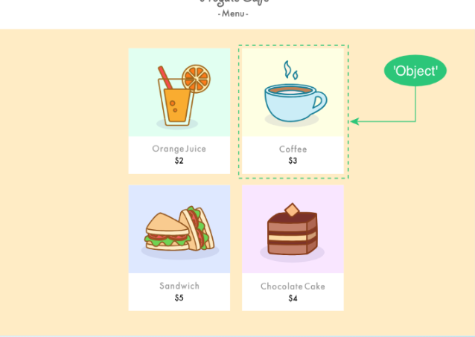
Objects of a menu
Are same as our object in python

Slide 4
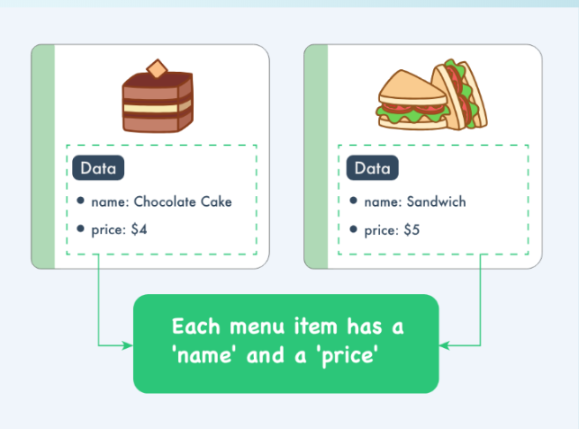
But these objects are different in themselves. How?

Slide 5
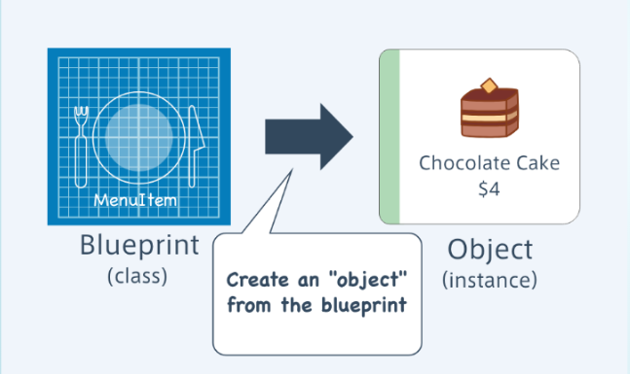
CLASSESS- GENERALISATION OF OBJECTS

Slide 6
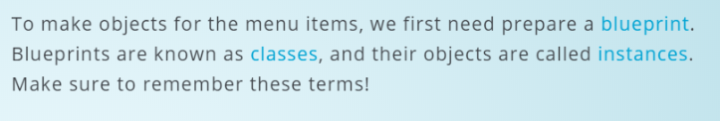
Definition-

Slide 7
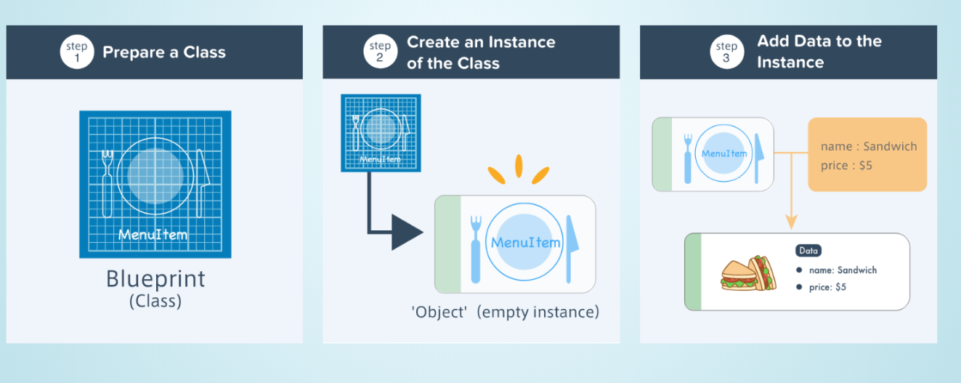

Slide 8
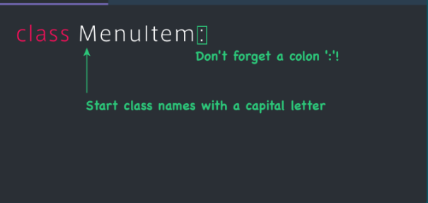
LETS MAKE THIS MENU -

Slide 9
So that now we have prepared the blueprint of the class . Let us make an actual menu item or instance( in python) using our menuitem class defined above

Slide 10
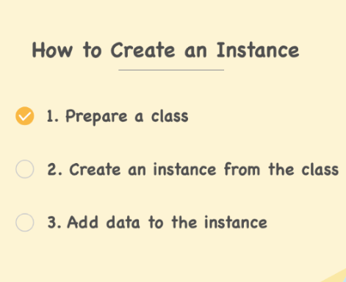
HOW TO CREATE THAT INSTANCE ?

Slide 11
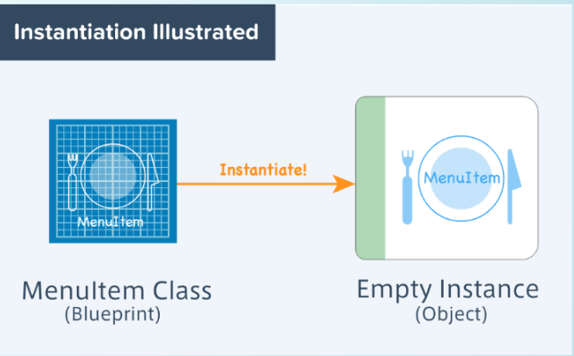
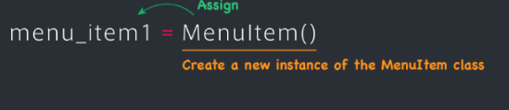

Slide 12
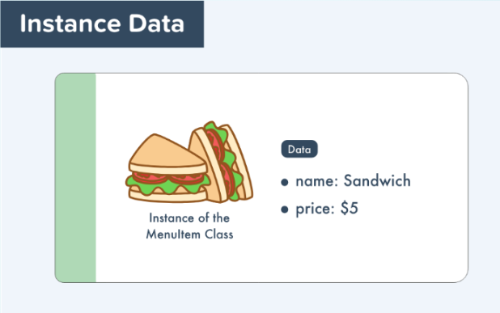

Slide 13
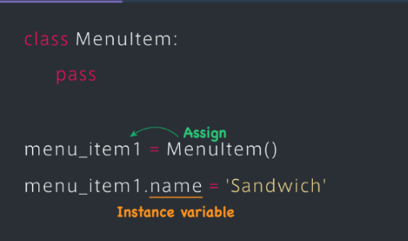
Adding data to instance -

Slide 14
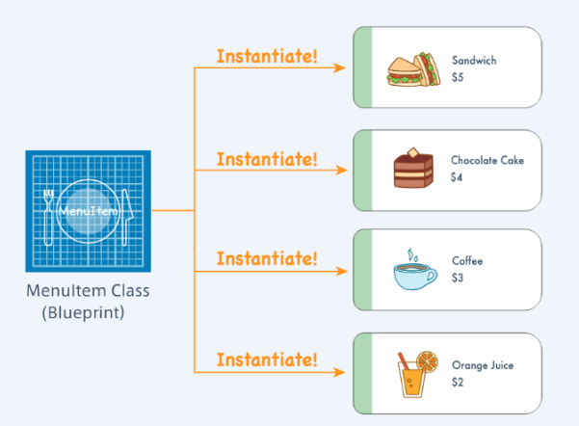
Multiple instances-

